Slide 1
STUDENTS FIRST
DISTRICT EDUCATIONAL SERVICES

Slide 2
AGENDA
Introductions and Welcome
Updated Counselor Manual
Credit for Prior Learning
Evaluator Business Process Guide and JIRA Updates
Lunch
Educational Services Updates

Slide 3
Welcome and Introductions
Fall 2022 Districtwide Counselor Conference

Slide 4
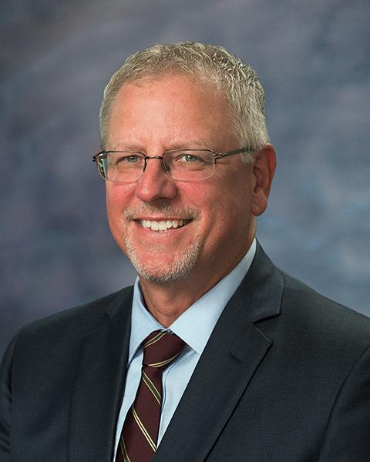
Welcome!
P. Wesley Lundburg, Ph. D. President
Miramar College

Slide 5
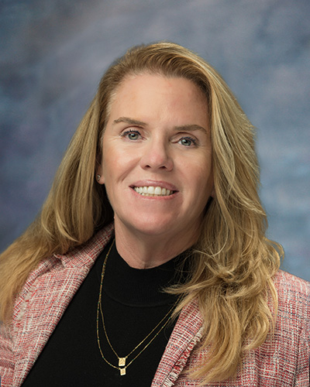
Welcome!
Susan Topham, Ed. D. Vice Chancellor Educational Services

Slide 6
GUIDING YOU IN CAMPUS SOLUTIONS
Updated Counselors Guide

Slide 7
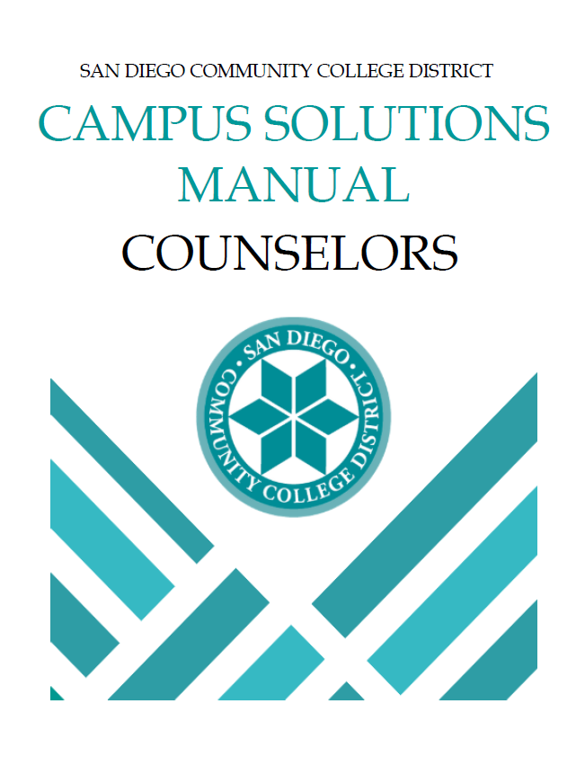
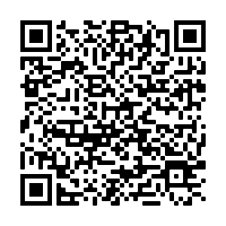
Campus Solutions Counselor Manual
https://mysdccd.atlassian.net/wiki/download/attachments/1015906305/Counselors%20Manual%203-1_Updated_2022.pdf?api=v2

Slide 8
Navigating Campus Solution
Counselor Manual Highlights
Enrollment Limits
98 Ed Plans
Sequence Numbers
Discontinued Students
The Future

Slide 9
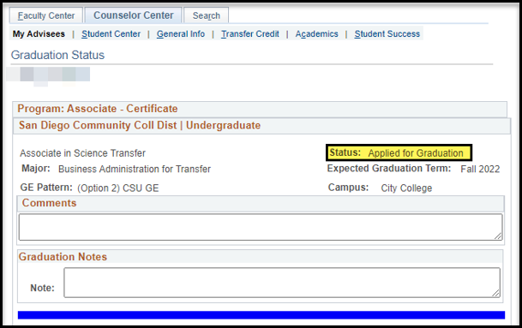
Counselor Manual Highlights
Counselor Manual has been updated. New job aids include Viewing Graduation Status and Updating Enrollment Limits
View graduation status via the student success page

Slide 10
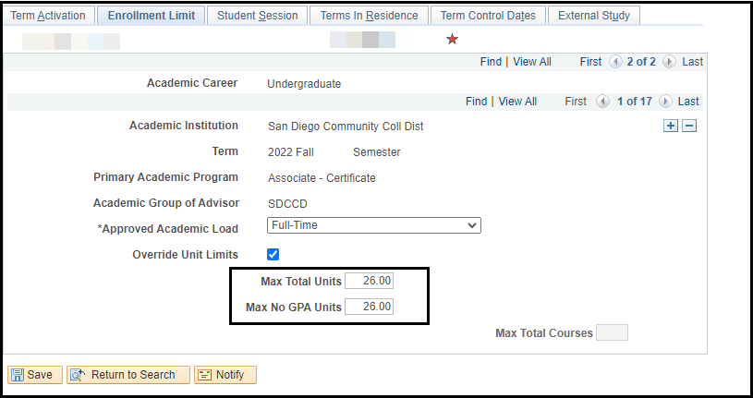
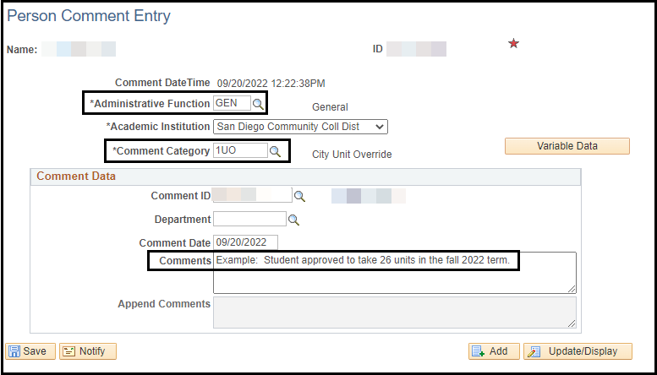
Enrollment Limits and Add Comment
New process removes the formal petition process for unit overrides.
Unit boxes have been modified to only show the two that need to be changed.
Comment categories are now 1UO, 2UO and 3UO
Department can be left blank when entering the comment

Slide 11
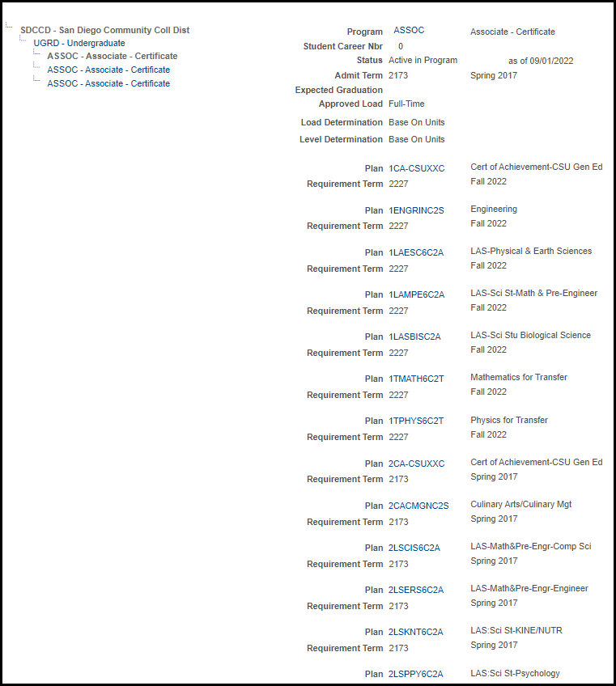
98 Ed Plans on the wall…
Students should only have education plans on their program/plan stack that the student is actively following.
Please be sure to delete/remove plans no longer being followed
This impacts students financial aid, clearinghouse reporting and impacts system performance.
Use the What-ifs

Slide 12
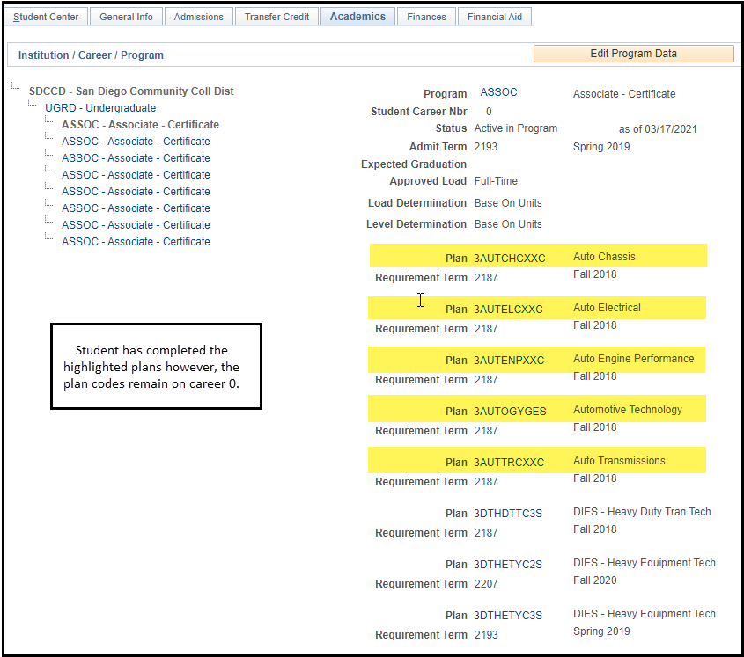
98 Ed Plans on the wall…
Student with completed plan codes still on Career 0.
Completed plan codes should be deleted.
Notes:
Student ID is 0000374256 and they are a current student (in case you need this)

Slide 13
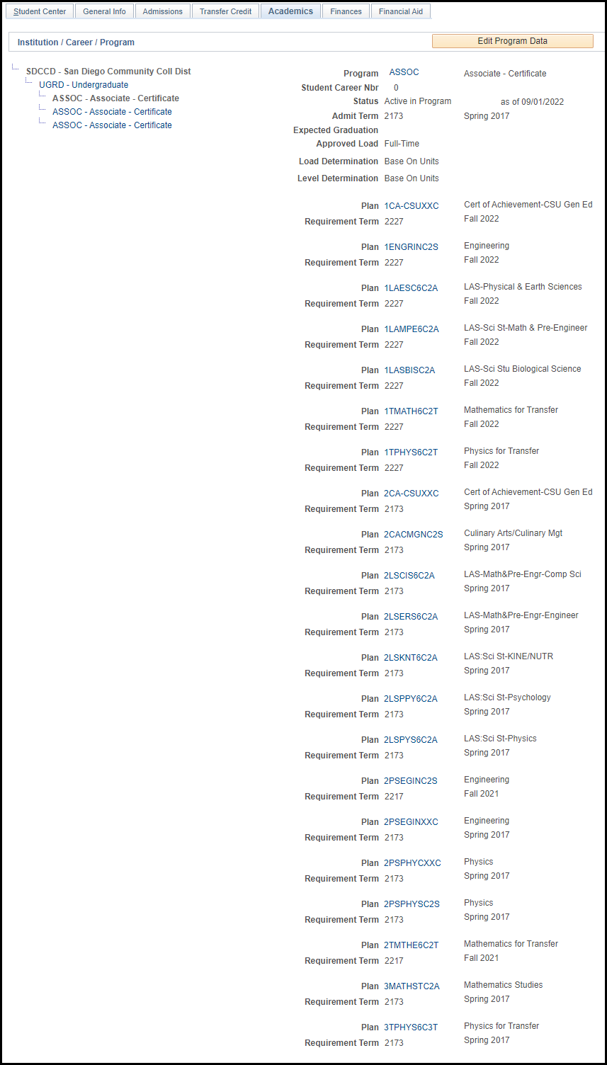
98 Ed Plans on the wall…
Please help us keep the CPP clean.
Helps students and your colleagues.
And Amy!

Slide 14
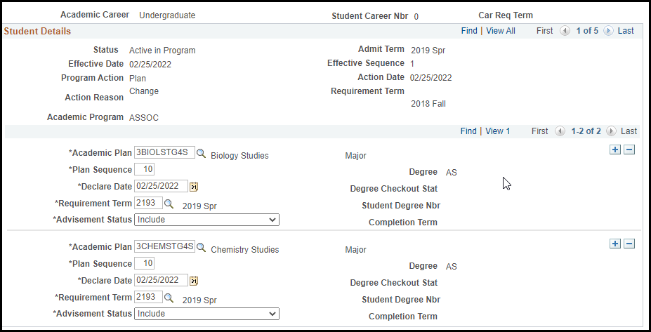
Sequence Numbers on the Student Plan Tab
The student’s primary plan should be the lowest sequence numbered plan.
Financial Aid and Veterans will only pay on the lowest numbered plan, no matter the advising status. This means if the student has both a 10 and 20, but the 10 is in to Do Not Include advising status and the 20 in Include, FA will still award based on the 10 plan code.
Sequence numbers should not be duplicated.
Notes:
I added this on Elaine’s record in case you need different screenshot (3330001215)

Slide 15
Sequence Numbers on the Student Plan Tab
Sequence numbers will either begin with 10 or 1
10 means they are a current or past conversion student from our legacy system
1 means they are new admit with no conversion record
Both 1 and 10 sequence numbers will sequence up by 10 automatically, when a new plan row is added. 1 will sequence to 11, 21, etc. 10 will sequence to 20, 30, etc.
Notes:
I added this on Elaine’s record in case you need different screenshot (3330001215)

Slide 16
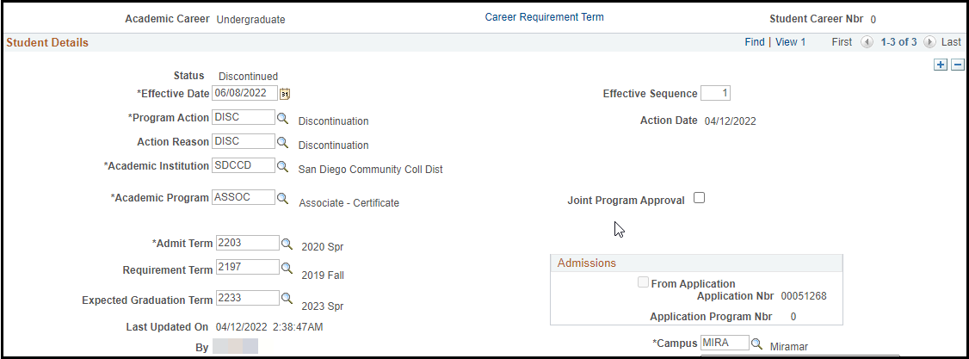
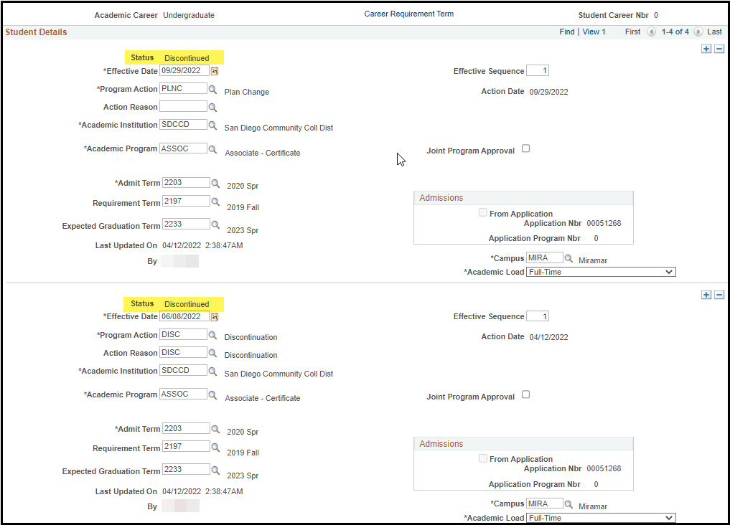
Discontinued Students
Check to be sure the student is in Active status. If the status is Discontinued, STOP. Do not add a PLNC row to their record. This will cause the student’s admission application to fail.
When a new PLNC row is added, the status does not update and remains in Discontinued status.
Do not add plans to the student’s program/plan stack for What-If purposes.
Notes:
I added this on Elaine’s record in case you need different screenshot (3330001215)

Slide 17
The Future
Looking for alternatives to the Student Success Page that is more user friendly.
Engaging in consultants to review our transcript evaluation process and academic structure.
Notes:
I added this on Elaine’s record in case you need different screenshot (3330001215)

Slide 18
CREDIT FOR PRIOR LEARNING
CREDIT BY EXAM
CREDIT FOR PRIOR LEARNING
Only for specific courses
Restricted to an examination proctored by faculty
$46.00/unit enrollment requirement
Student must be currently enrolled
More variety of courses can by offered
Three methods: Portfolio, industry certifications, credit by exam
Free!
Students may accept/decline credit
Emphasis on non-credit CPL

Slide 19
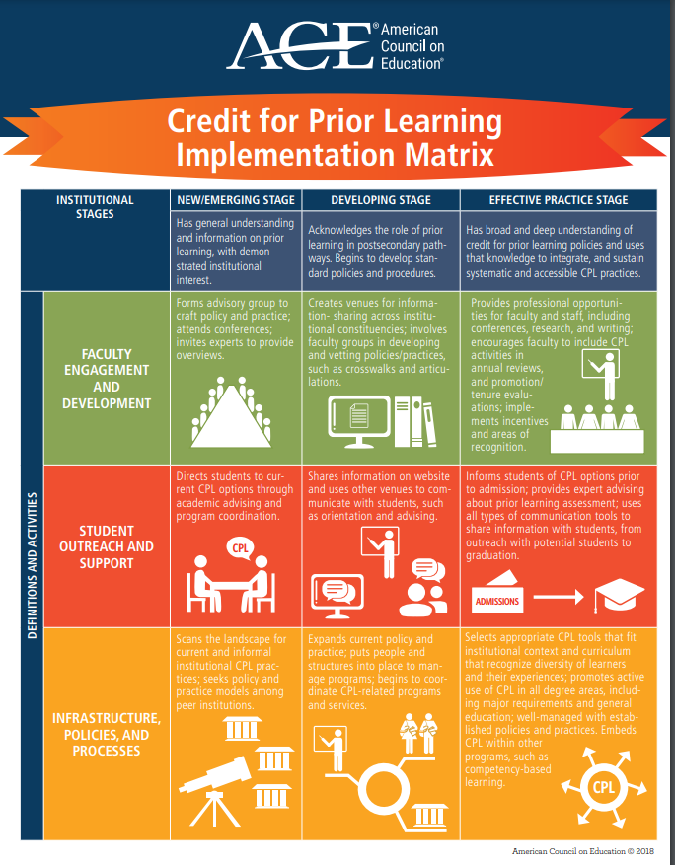
CREDIT FOR PRIOR LEARNING
Definition
Credit for Prior Learning (CPL) is college credit awarded for validated college-level skills and knowledge gained outside of a college classroom (Administrative Procedure AP-3900.4).
Credit for prior learning may be earned for eligible courses approved by the faculty for students who satisfactorily pass an authorized assessment.

Slide 20
CREDIT FOR PRIOR LEARNING
Authorized Assessments
Evaluation of approved external Standardized Examinations:
Advanced Placement (AP) examination
International Baccalaureate (IB) examination
College Level Examination Program (CLEP)
DANTES
Processed via External Education

Slide 21
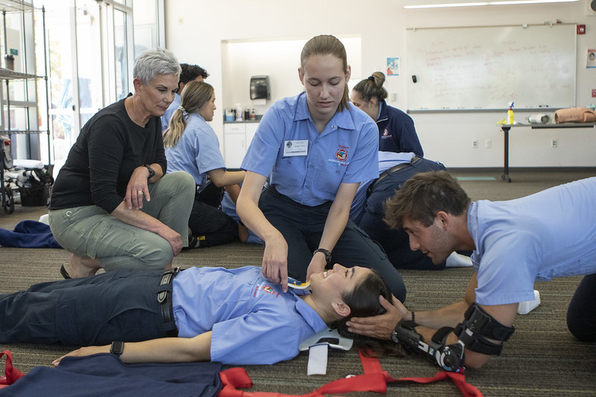
CREDIT FOR PRIOR LEARNING
Authorized Assessments Continued
Credit by Examination: satisfactory completion of an institutional examination, administered by the college
Evaluation of Military Transcripts (in development);
Evaluation of Industry Recognized Credentials; and/or
Evaluation of Student-Created Portfolios.

Slide 22
CREDIT FOR PRIOR LEARNING
Student Journey
Things to consider…
How will students learn about their CPL opportunities?
Who can students contact for guidance through the CPL process?
Do students have a dedicated Resource to discuss the following:
Is CPL the right choice?
Are there any transfer issues with CPL?
Does the student have their education plan on file?

Slide 23
CREDIT FOR PRIOR LEARNING
Student Journey
Is the CPL Petition process easy and accessible for students?
What support is available to students to help them succeed?
Portfolio review requirements
Exam preparation
Military Transcript submission process
Industry Certificate review and submission process

Slide 24
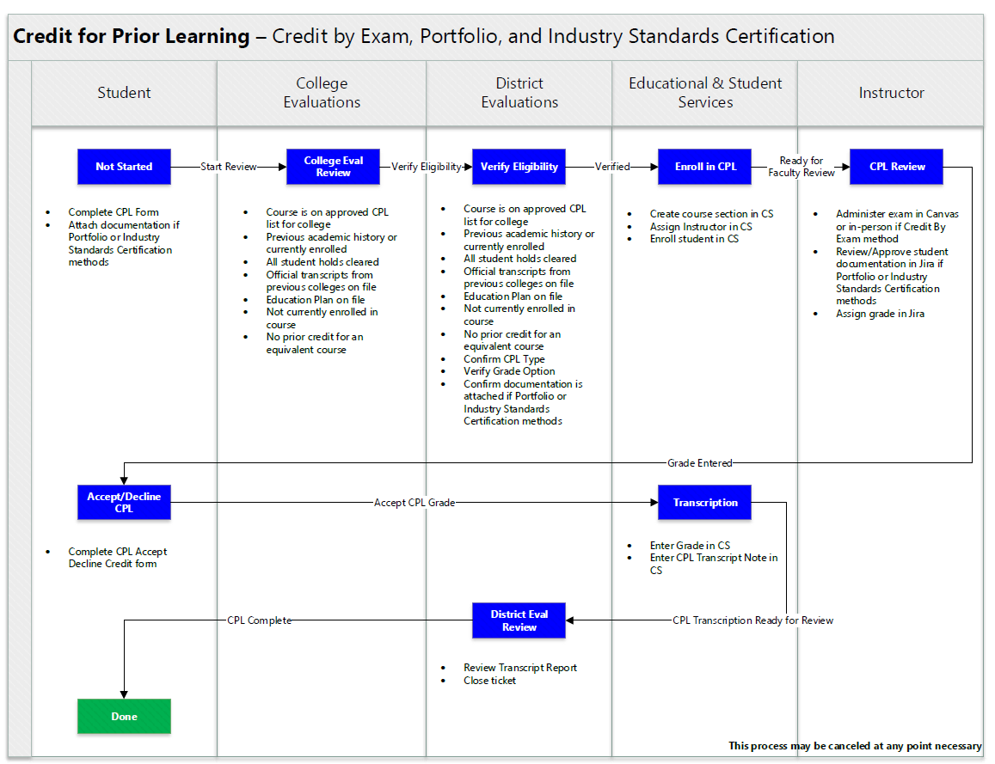
CREDIT FOR PRIOR LEARNING PROCESS
JIRA
Student completes CPL form
College Evaluations Office Reviews
District Evaluations Verifies Eligibility
Educational Services Enrolls Student in CPL

Slide 25
CREDIT FOR PRIOR LEARNING PROCESS
JIRA
Instructor Administers Exam or Approves Documentation
Instructor Assigns Grade
Student Accepts or Declines Credit
District Evaluators Review
CPL Transcripted by Educational Services

Slide 26
CREDIT FOR PRIOR LEARNING
Resources
BP 5235 Credit for Prior Learning
AP 5235 Credit for Prior Learning
City College Catalog
Mesa College Catalog
Miramar College Catalog
CPL Course List

Slide 27
CREDIT FOR PRIOR LEARNING
Resources
Additional Outside resources
Credit for Prior Learning pilot at Palomar College
CAEL CPL Free Resource Kit
Success Center for California Community Colleges Credit for Prior Learning Initiative
CPL Toolkit

Slide 28
BREAK

Slide 29
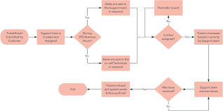
EVALUATOR BUSINESS PROCESS GUIDE
Highlights of Changes
Updated Evaluator Alphabet
Restructured by Topics
Streamlined to align with online JIRA Processes
PDF
Online coming soon!

Slide 30
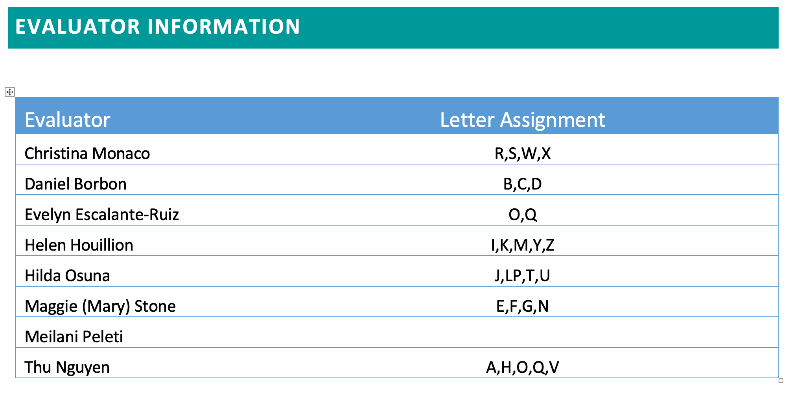
EVALUATOR BUSINESS PROCESS GUIDE
9th Evaluator
Evaluator Alphabet

Slide 31
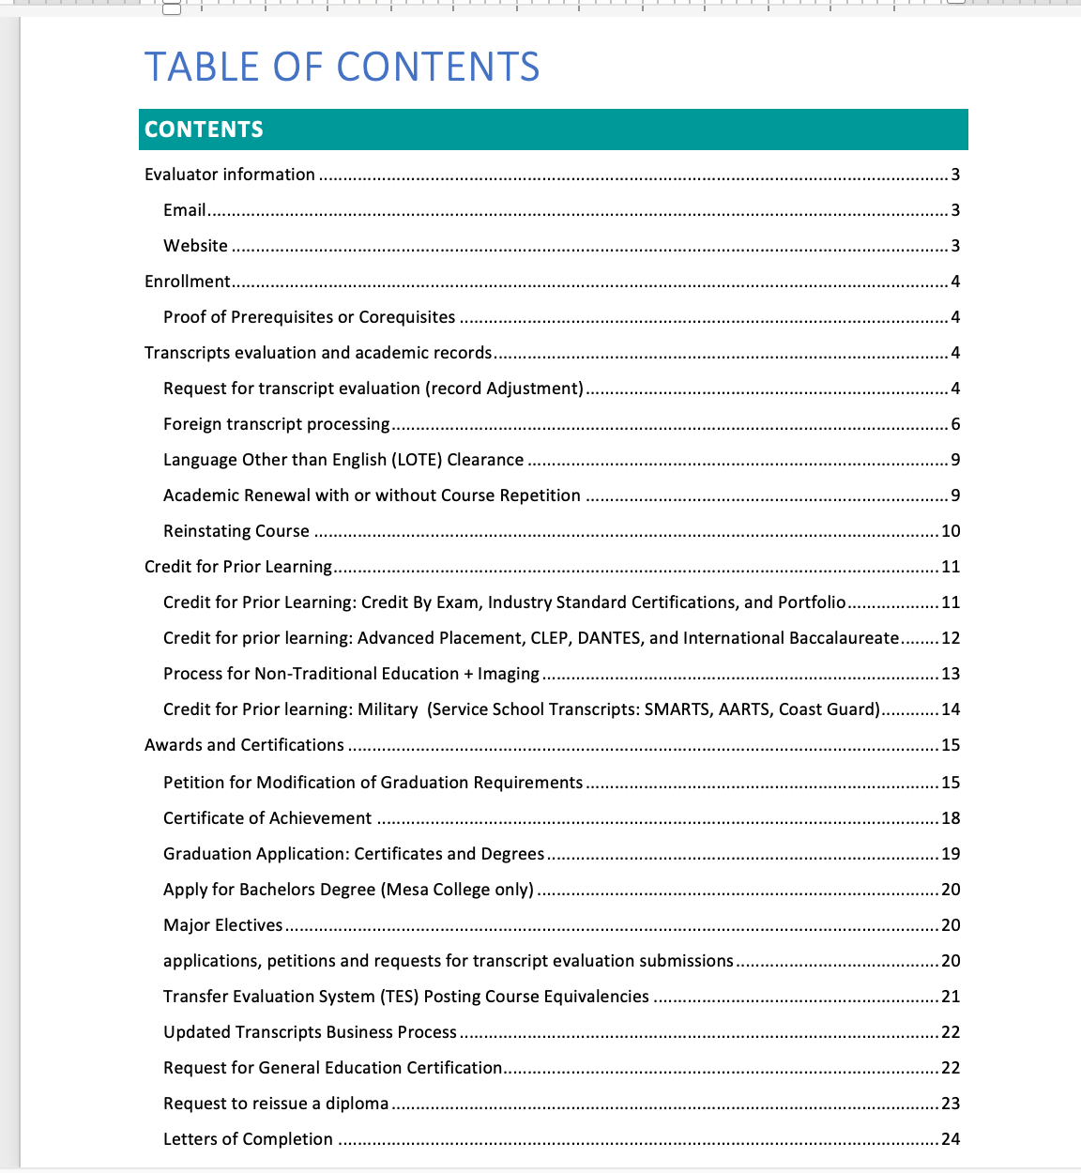
Evaluator Business Process Manual
Organization
Evaluator Information
Enrollment
Transcripts Evaluation and Academic Records
Credit for Prior Learning
Awards and Certifications
Deadlines for Evaluations Processes

Slide 32
JIRA UPDATES
Most JIRA forms are now 100% online
Working to streamline student petition forms:
Petition for Excused Withdrawal
Student Petition
Late drops with refund
Code out Ws (10+ years)
Merge Exception to course repetition
Late add/drop
Grade Challenge
Readmission to Allied Health Program
Petition for Loss of Enrollment Priority and/or CCPG
250,000+ tickets submitted
Adoption by IT help desk, HR, Research, OLP, ????

Slide 33
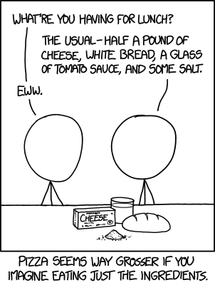
LUNCH TIME
11:30 to 12:00

Slide 34
EDUCATIONAL SERVICES UPDATES
ADTs
Baccalaureate Degrees
Common Course Numbering
Online Catalog
CalGETC
Fall 2023 Registration
Ethnic Studies
PRT
Legislative Updates

Slide 35
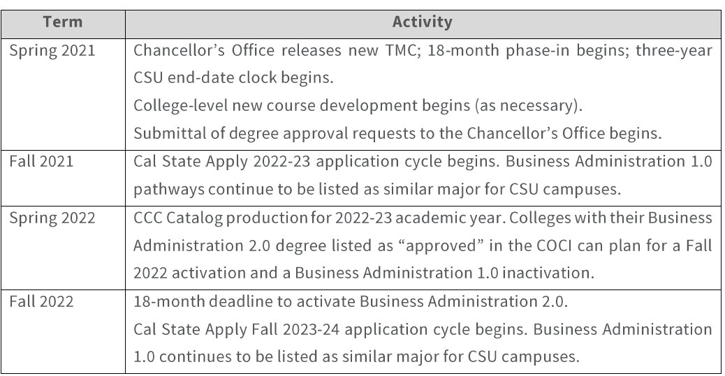
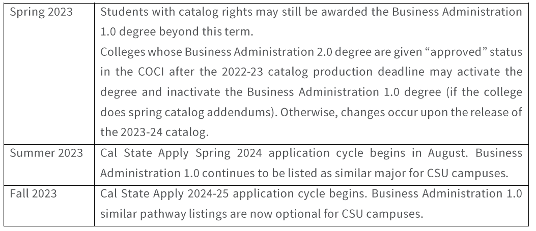
EDUCATIONAL SERVICES UPDATES
ADTs
Associate Degree for Transfer: Guidance on Degree Versioning Phase Out
Effective immediately, CSU campuses will retain similar pathways for ADTs for no less than three years from the date of the new TMC’s release date. Once a new version is developed, the CSU campuses may opt to no longer designate similar pathways for the prior version.
Deactivation: Business Administration (1.0)
New Fall 2023 : Communication Studies 2.0

Slide 36
EDUCATIONAL SERVICES UPDATES
ADTs
One active version of a degree to ensure there is a clear transition
Student Catalog Rights and ADT awards: community colleges may continue to confer the prior degree version based on local college catalog rights—students should be made aware of the reduced availability of CSU similar pathways after 3 years.
Deactivation: Business Administration (1.0)
New Fall 2023 : Communication Studies 2.0

Slide 37
EDUCATIONAL SERVICES UPDATES
CITY COLLEGE
Provisional Approval: Cyber Defense and Analysis, Bachelors of Science
Baccalaureate Degrees

Slide 38
EDUCATIONAL SERVICES UPDATES
Common Course Numbering

Slide 39
EDUCATIONAL SERVICES UPDATES
CurrIQnet Meta and Online Catalog
Overview of Process and Tentative Timeline:
Three Phases: course, programs, catalog.
Configuration (forms and workflow) of the system of courses and program. Reconfigure the base system to meet our needs.
Review current list of reports: identify what is needed; wish list of reports
Tentative Timeline:
Meta: Implement December 2023
Catalog: 2024-2025 (Go live)

Slide 40
Educational Services Updates
Area | Proposed CalGETC Pathway
1 | English Composition 1 course (3 semester/4 quarter units)* Critical Thinking and Composition 1 course (3 semester/4 quarter units)* Oral Communication 1 course (3 semester/4 quarter units)*
2 | Mathematical Concepts and Quantitative Reasoning 1 course (3 semester/4 quarter units)*
3 | Arts 1 course (3 semester/4 quarter units)* Humanities 1 course (3 semester/4 quarter units)*
4 | Social and Behavioral Sciences 2 courses (6 semester/8 quarter units)*
5 | Physical Science 1 course (3 semester/4 quarter units)* Biological Science 1 course (3 semester/4 quarter units)* Laboratory (for Phys/Bio Science) 1 semester/1 quarter unit*
 | Life Long Learning and Self Development Not required (CSU Upper Division GE)
6 | Language other than English (LOTE) (Currently UC only, carries no units)
7 | Ethnic Studies 1 course (3 semester/4 quarter units)*
AB 928: Student Transfer Achievement Reform Act
Requires ICAS to establish a singular lower division general education pathway
Draft disseminated for feedback
Establishes the ADT Intersegmental Implementation Committee
Committee will begin this fall and be chaired by the CCCCO
Requires the CCCs to automatically place students on ADT pathways
TBD

Slide 41
Educational Services Updates
Summer 2023 Registration
Fall 2023 Registration
Fall 2023 Registration

Slide 42
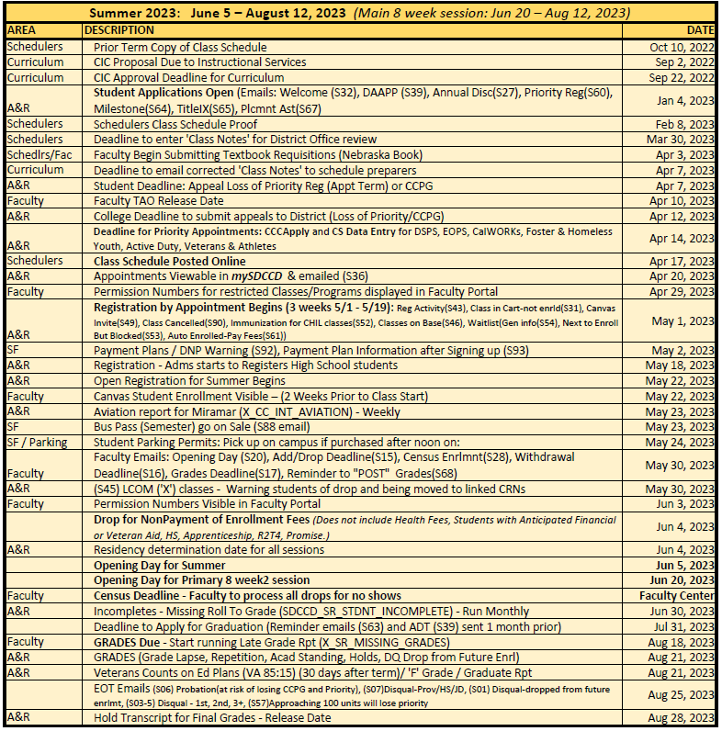
2023 Registration

Slide 43
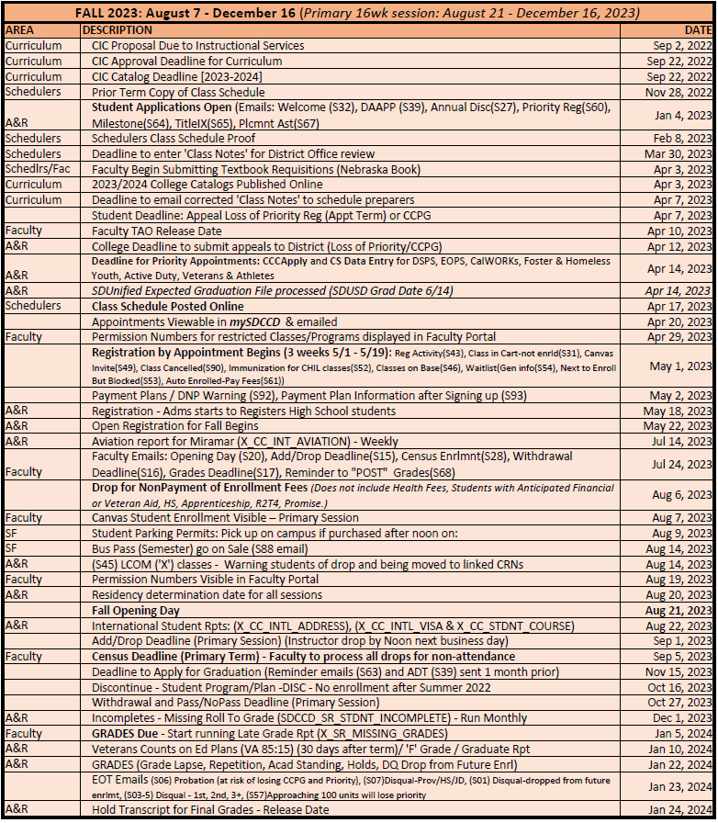
2023 Registration

Slide 44
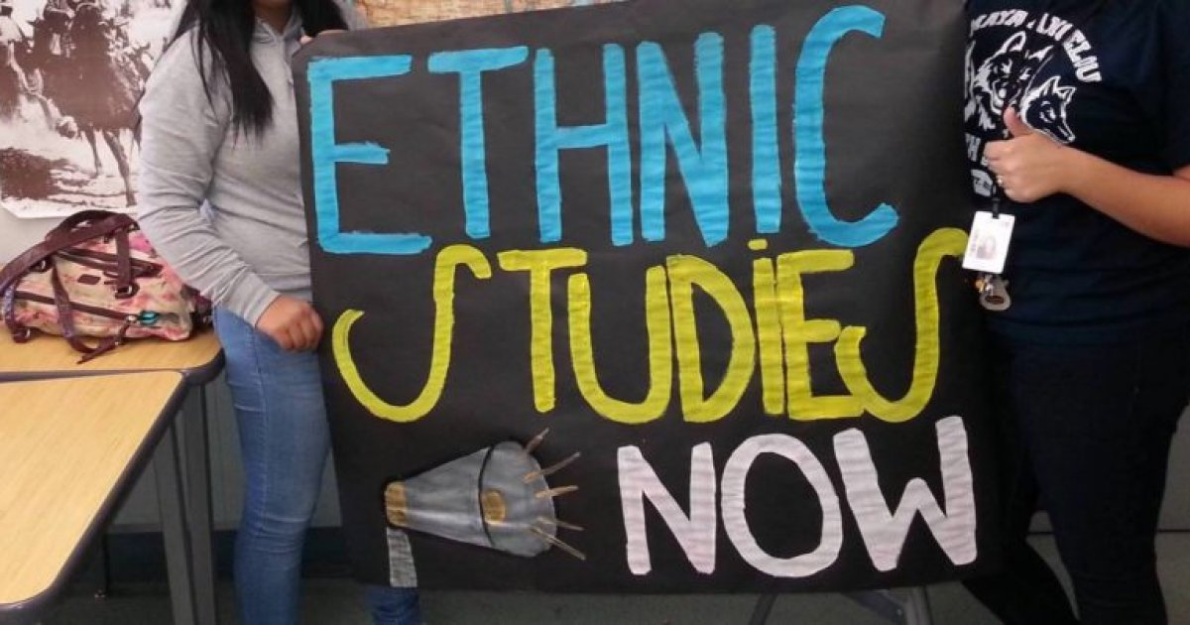
Educational Services Updates
Ethnic Studies
CSU GE Area F: CHIC 110A, CHIC 110B, FILI 100
The IGETC pattern will include Area 7 Ethnic Studies starting in Fall 2023 for the 2023-2024 academic year.
The IGETC 2.3 document includes a new section (Section 13.0) that previews the forthcoming list of changes required to IGETC Standards 2.3 in order to implement Area 7 Ethnic Studies starting in Fall 2023 (for the Standards, Policies, and Procedures for IGETC Version 2.4).
During the 2022-2023 academic year, the CCC may prepare CCC Ethnic Studies courses using the Section 13.0 guidelines (noted in Standards, Policies, and Procedures for IGETC Version 2.3) to ready these courses to meet the Ethnic Studies Core requirements for Fall 2023.

Slide 45
Educational Services Updates
PRT
Streamline and expedite processes by making better use of digital forms, signatures, and workflows
Identify and implement more efficient ways of operation and/or hire a PeopleSoft expert to aid users in more nimbly using the system
Document infrastructural barriers to student success and completion, and develop and implement a plan for resolving these issues
Provide professional development for all constituencies focused on improved student onboarding and how to best facilitate an excellent student experience
Click here for PRT Plan

Slide 46
Legislative Updates
Bill | Name | Description | Status
AB-1187 | Community colleges: tutoring. | Would expand the type of noncredit courses eligible for state apportionment funds to include supervised tutoring for all credit and noncredit courses offered at the community colleges. | PASSED
AB-1655 | State holidays: Juneteenth. | Would create a state holiday on June 15th to commemorate Juneteenth. | PASSED
AB-1705 | Seymour-Campbell Student Success Act of 2012: matriculation: assessment. | Would prohibit colleges from placing and enrolling students in pretransfer-level math or English coursework except under very limited circumstances, provide clarifying amendments to current equitable placement practices consistent with existing regulations and guidance, and require colleges to utilize data and local research evidence to inform a student’s placement and concurrent support. | PASSED
AB-2881 | Public postsecondary education: students with dependent children. | Would require public institutions of higher education to grant priority enrollment to student parents and ensure students have specified information to enroll in the California Special Supplemental Food Program for Women, Infants, and Children (WIC). | PASSED
SB-964 | Behavioral health. | Would require the CCCs, CSU, and UC to develop two accelerated programs of study related to associate’s degrees, bachelor’s degrees, and master’s degrees in social work. | VETOED
SB-1141 | Public postsecondary education: exemption from payment of nonresident tuition. | Would remove the two-year cap on full-time enrollment in credit courses that can be counted towards achieving AB 540 status and change the threshold to qualify from three to two years of full-time attendance. | SIGNED

Slide 47
Legislative Updates
AB-1958 | The Community College Student Access, Retention, and Debt Cancellation Program. | Would establish the Community College Student Access, Retention, and Debt Cancellation Program to support efforts to increase student retention rates and enrollment by engaging former community college students who may have withdrawn from a community college due to the impacts of the COVID-19 pandemic. | PASSED | Yes
AB-2683 | Postsecondary education: sexual violence and harassment: training and resources. | Would require UCs, CSUs, and CCCs campuses to annually train students on sexual assault and harassment prevention. | PASSED | Yes
AB-2810 | Student nutrition: CalFresh: student eligibility: Federal Application for Student Aid data. | Would require the CSU and CCCs to use FAFSA data to identify students who meet the income requirements of the CalFresh program. | PASSED | Yes
AB-1232 | Community colleges: nonresident tuition fees: English as a second language courses. | Would add an exemption for payment of nonresident tuition fee at a California Community College to certain nonresident students who enroll in a credit English as a second language (ESL) course. | SIGNED | Yes

Slide 48
THANK YOU
Educational Services

